Slide 1




Weekly report: Team Gearbox, Brake, Coupling
Week number : 04
Date: 21/10/2025
Supervisor: Prof. Peter Quell
Group Members :Nehang Jitendra Joshi,Santo Mazumder,Md Razaul Karim Rahat
Presented by -Santo Mazumder
21-10-2025
Gearbox, Brake, Coupling

Slide 2
Agenda for 4th week
Gearbox configuration
Gear box Stages and Technical Inputs
Gearbox calculation
21-10-2025
Gearbox, Brake, Coupling

Slide 3
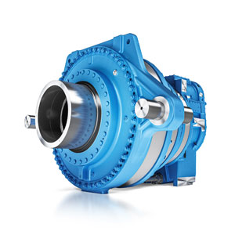
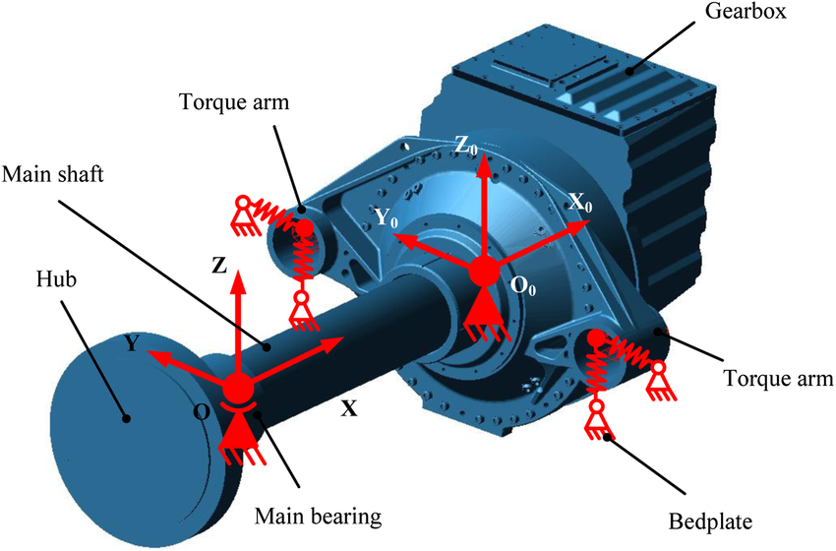
Gear box configuration
Reference: Research gate
Reference: Winergy
21-10-2025
Gearbox, Brake, Coupling

Slide 4
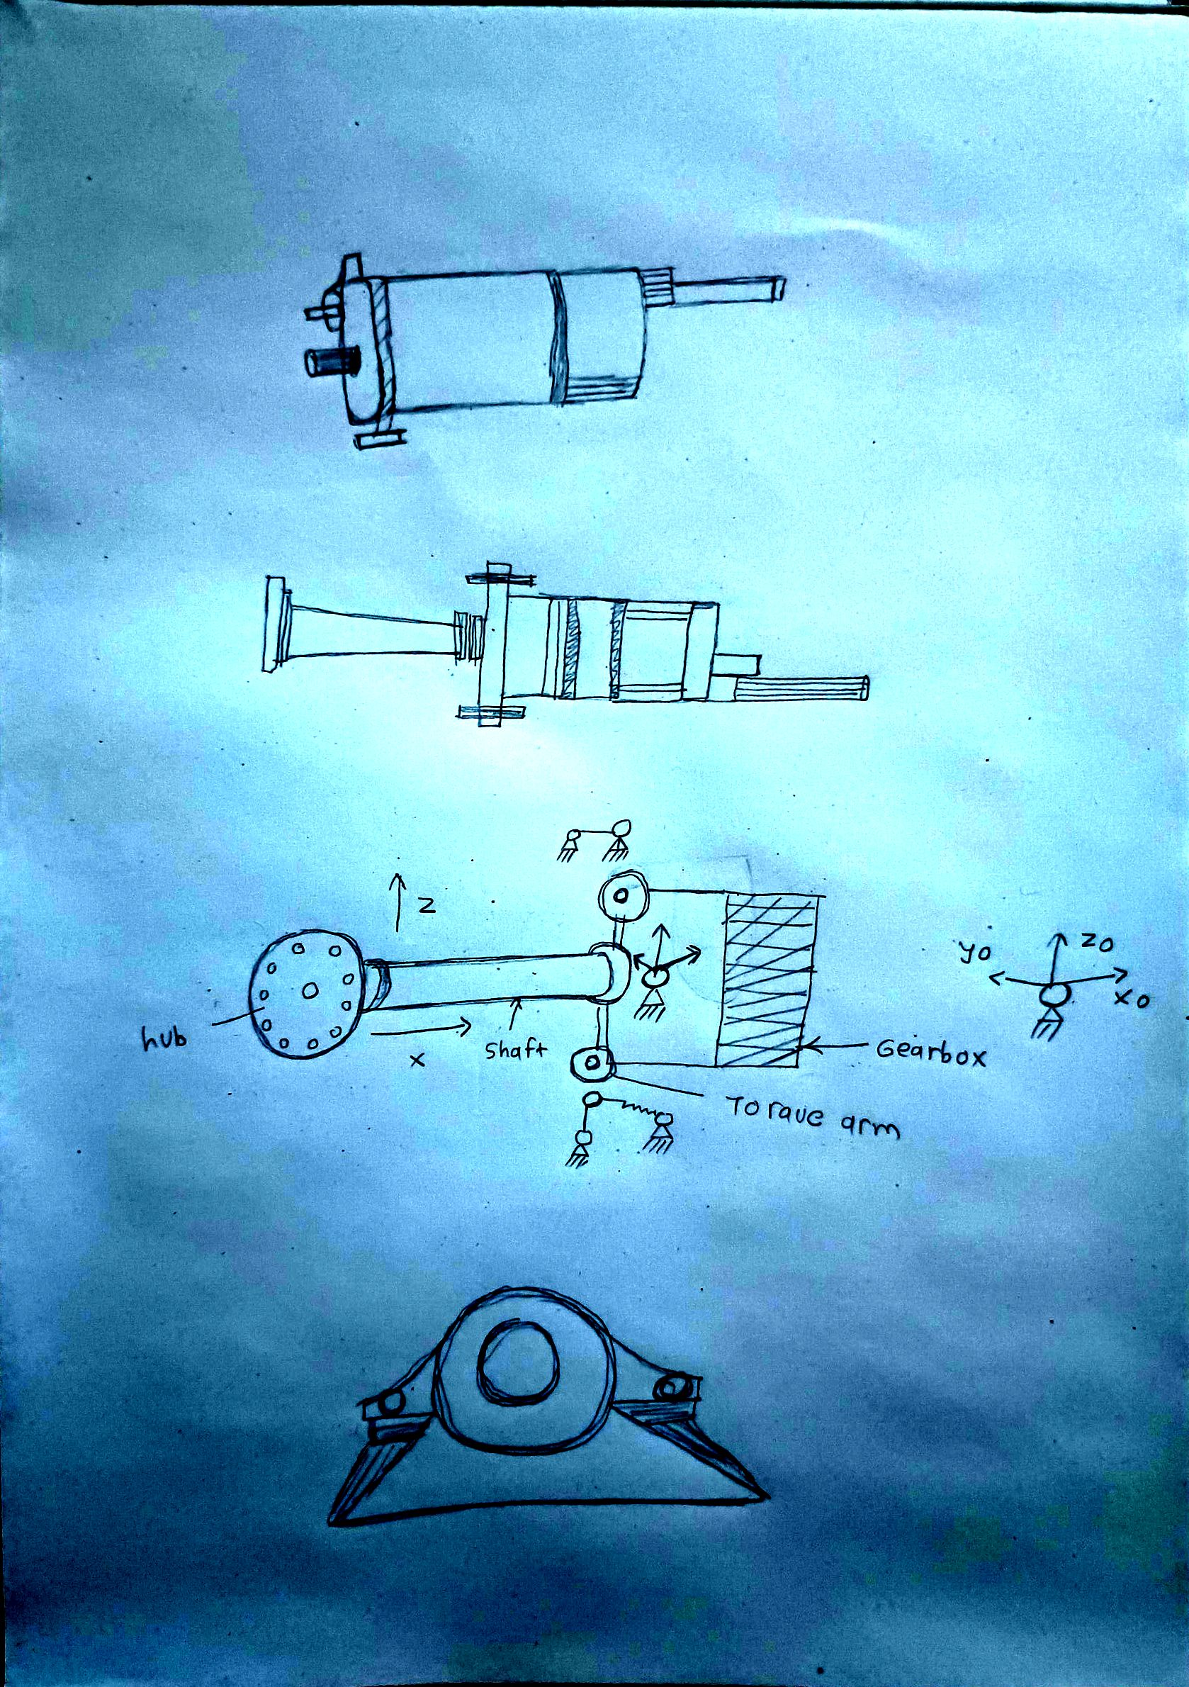
Sketch
21-10-2025
Gearbox, Brake, Coupling

Slide 5
Gear box Stages and Technical Inputs
Parameter for gears
Module
Teeth
Pressure Angle
Pitch Dia.
Gear Ratios
Number of Teeth on Sun Gear
Number of Teeth on Planet Gear
Number of Teeth Ring Gear
Clearance
Backlash
21-10-2025
Gearbox, Brake, Coupling

Slide 6
Gear box Stages and Technical Inputs
>Spur Gear Efficiency 97-99 %
>Planetary Gear Efficiency -97 %
Dimensioning of the gearbox
-IEC-61400-4 (Design requirements for WEC gearboxes)
Dimensioning of the gearbox components
-ISO 281 (Roller bearings-dynamic load ratings and life)
-ISO 76 (Roller bearings-Static load ratings)
-ISO 6336-1 (Calculation of load capacity of spur and helical gears)
Reference: Lecture notes Prof. Dipl.-Ing. Peter Quell 06/10/2019
21-10-2025
Gearbox, Brake, Coupling

Slide 7
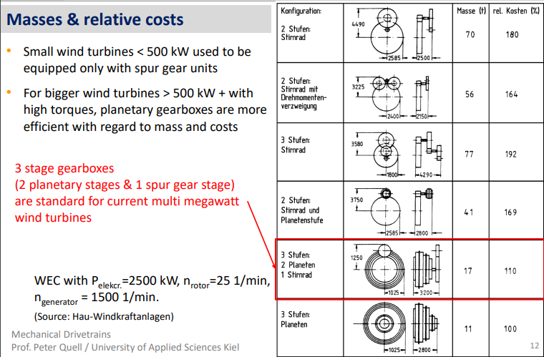
Gearbox system
21-10-2025
Gearbox, Brake, Coupling

Slide 8
Gearbox system selection
Two Planetary Stage​ + 1 spur gear stages ​ Material-Cast Iron(gearbox Case),Forged Steel(Gear)​
Gear ratio assumed as per current i 130
I1 * I2 * I3 = 130
5 * 5 * 5.2 =130
​ ​ ​ ​ ​
21-10-2025
Gearbox, Brake, Coupling

Slide 9
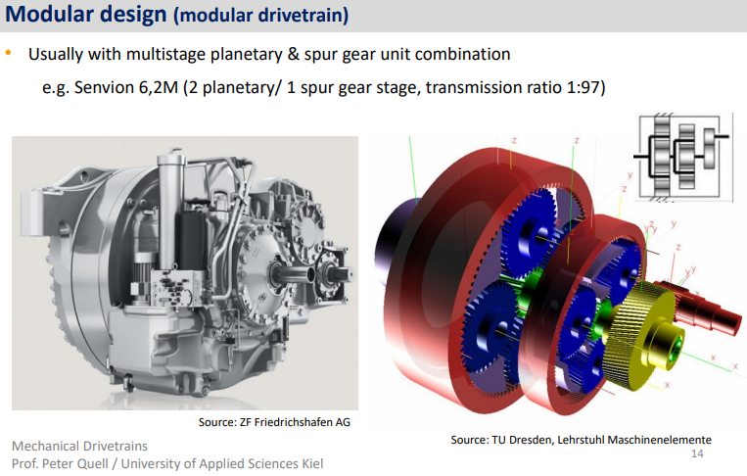
Gearbox system
21-10-2025
Gearbox, Brake, Coupling

Slide 10
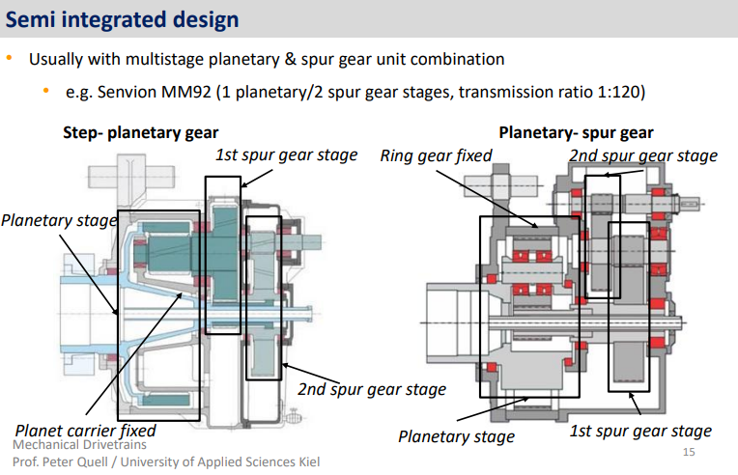
Gearbox system
21-10-2025
Gearbox, Brake, Coupling

Slide 11
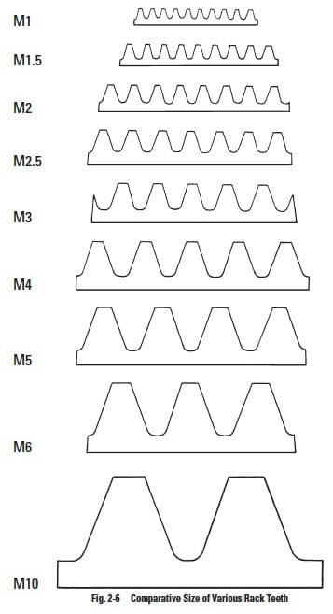
Gearbox system module
Factors of Module
Different Modules ( 1,1.5,2,2.5,3,4,5,6 & 10)
Should we put the same modules for all the
stages Or different..?
Selection of Module:
Module for 1st Stage Planetary Gear=____
Module for 2nd Stage Planetary Gear=____
Module for Spur Gear=____
Reference: https://images.app.goo.gl/JmUqJcked765T6fL6
21-10-2025
Gearbox, Brake, Coupling

Slide 12
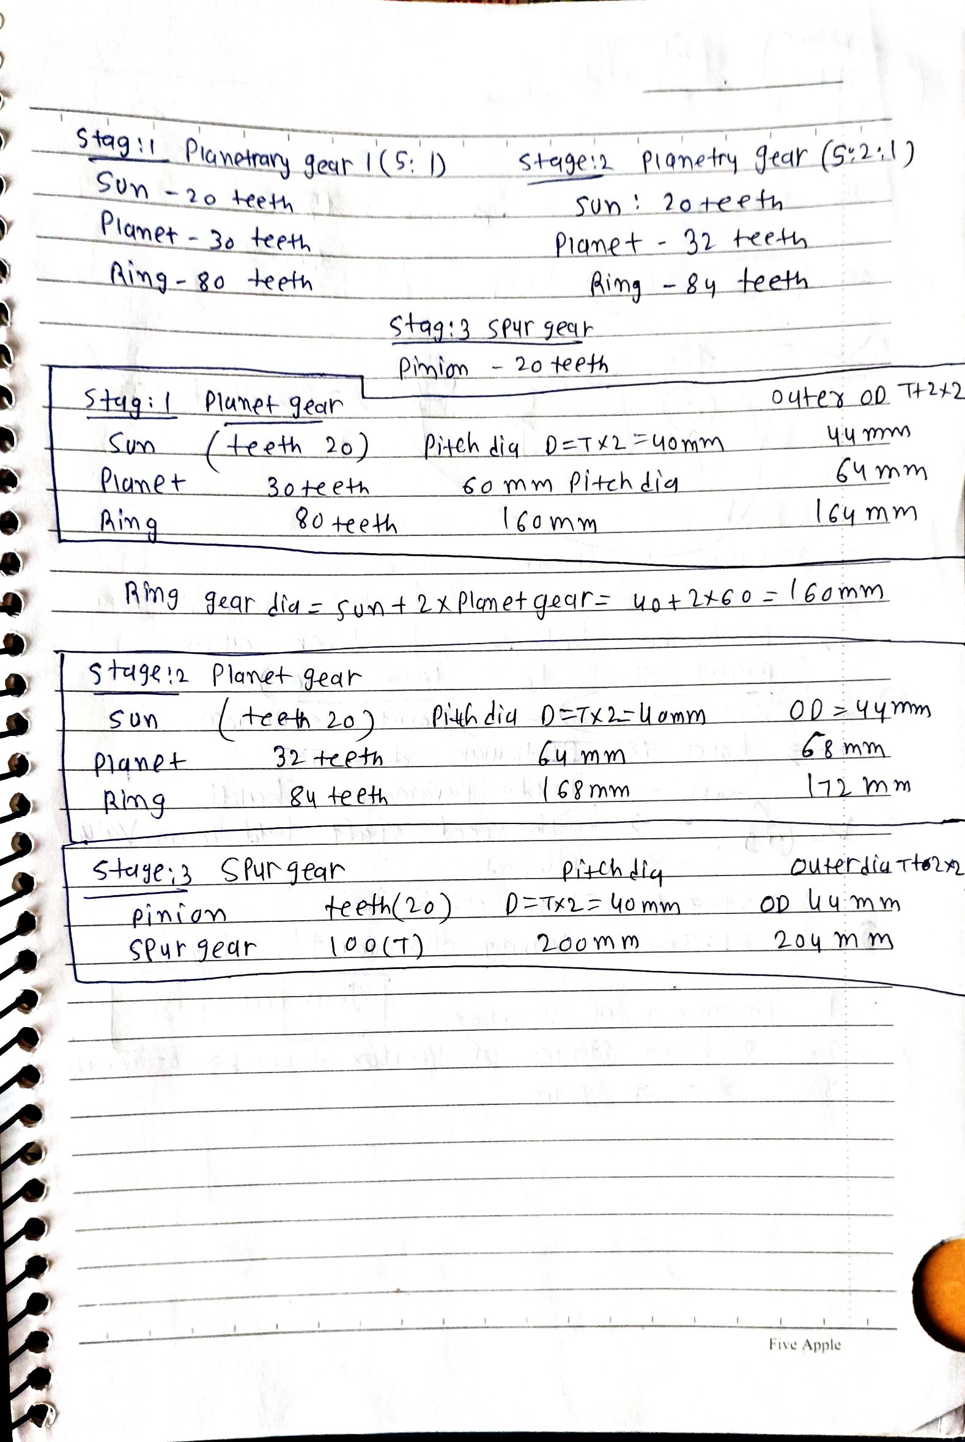
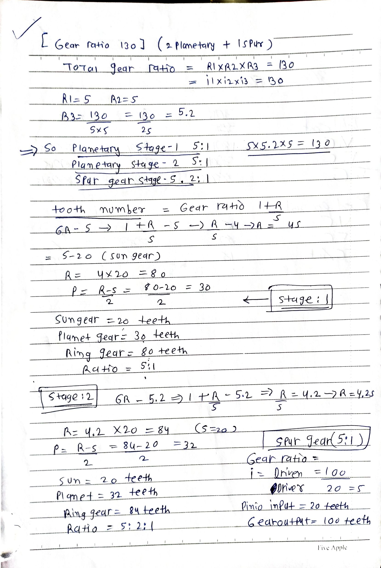
Gearbox
Gearbox Calculations​
21-10-2025
Gearbox, Brake, Coupling

Slide 13
Gearbox formula
Finding rpm on each gear of planetary gearset
Finding rpm on each gear of spur gearset
In this condition, ring gear is fixed..
By using Willis Equation: n_{sun} – i₀ * n_{ring} –(1-i₀)*n_{pc} = 0
n_{sun} = Speed of Sun gear
n_{ring} = Speed of ring gear
n_{pc} = Speed of Planet Carrier
i₀ = Gear ratio between Sun & Ring gear
21-10-2025
Gearbox, Brake, Coupling

Slide 14
Gearbox system
Solid Work process
Part Modelling
This module is used to model intricate shapes and parts that are made to make a component.
Assembly Module
This module is to make a final product by assembling all the parts modelled in the Part modelling module.
Drafting
Drafting is used to generate a Production Grade schematic which will be sent to the manufacturer for producing the component.
The drafting sheet include that dimensions, Surface Roughness value, Component Material and Bill of Materials.
SolidWorks Simulation
SolidWorks Simulation is an essential tool to analyze the behavior of the component upon the loading conditions applied by the user applied by the user.
21-10-2025
Gearbox, Brake, Coupling

Slide 15
Bibliography
Gearbox
(1) Previous year Optimus projects
(2) IEC-61400-4
(3) Lecture notes – Mechanical drive train by Prof.Peter Quell.
(4)ZF Wind and Winergy website
21-10-2025
Gearbox, Brake, Coupling

